Slide 1
10. 2AWS Elastic Compute Cloud AWS EC2
In Amazon Web Service (AWS) cloud environment, Elastic Compute Cloud (EC2) is a service. Using EC2 you can create a virtual machine which is known as EC2 Instance. AWS provides a virtual environment where you create an EC2 Instance which replaces your hardware need. Using EC2 you can save a huge investment cost to run your physical environment. You can develop and deploy web applications in less time. EC2 created instances are scalable to handle changes and provide multiple layers of security.
As we know that AWS Cloud Computing provides delivery of IT resources on- demand, and it is based on pay-as-you-go pricing model. If you compare running cost of your physical environment with AWS cloud services, it is very economical and provides many features as well.
1. Preconfigured Machine Template – AMI:
In AWS Cloud Computing, you create instances by using templates of instances, which is known as Amazon Machine Image (AMI). By using a preconfigured template of a machine, you can create numbers of Instances of similar instances in very less time. AMI contains image of a running an Operating System (OS) such as Linux or Window OS. In AMIs you can also include some specific application and configurations as per requirement.
You can use available AMIs from AWS which are available in four different resources:

Slide 2
Quick Start: In this resource, most frequently used AMIs of various OS are available.
For Example:
Amazon Linux AMI 2017.09.1 (HVM), SSD Volume
b.
c.
d.
Ubuntu Server 16.04 LTS (HVM), SSD Volume
Amazon RDS
Microsoft Windows Server 2016 Base with
Containers
e.
Microsoft Windows Server 2016 with SQL Server
2017 Web etc.
ii. My AMIs: You can create your own AMIs to create Instances and you can also share those AMIs to other AWS accounts.
iii.
AWS Marketplace: Some vendors provide their customized or product AMIs, you can search and purchase them. You can search number of developer tools, business software and software infrastructure AMIs.
The list of AMIs at AWS Marketplace is being increased regularly.
iv. Community AMIs: In this resource, you can find number of popular and OpenSource communities. They are providing AMIs of various Operating Systems for example Amazon Linux, CentOS, Fedora, RedHat, Windows, Ubuntu etc.
2. Instance Type:
In order to launch an instance (virtual machine), you do require two things. First is an Operating System which is available for selection in terms of AMI. Second is hardware resource on which this Operating System will be installed, for example a combination of CPU, memory, storage and other resources.
In AWS EC2 service various combination of instance resources are provided which are categorized in instance types. You can select an

Slide 3
instance type which suits your requirement to run the instance. After launching an Instance, it exactly looks like a traditional machine. You can take remote of the Instance by using remote protocol such as RDP in Windows or SSH in Linux.
In Instance type you can find various types of combinations of CPU, memory, storage and other resources. For in-depth idea about Instance Type follow the description in tabular form, which would help you to choose an appropriate combination of resources for your need.
General Purpose (t2)
Memory Optimized (r4 or x1e)
GPU Compute (p2)
Storage Optimized (d2, i2 or i3)
Compute Optimized (c5)
Some Examples of Instance Types:
Model | vCPU | CPU Credits / hour | Mem (GiB) | Storage
t2.nano | 1 | 3 | 0.5 | EBS-Only
t2.micro | 1 | 6 | 1 | EBS-Only
t2.small | 1 | 12 | 2 | EBS-Only
t2.medium | 2 | 24 | 4 | EBS-Only
t2.large | 2 | 36 | 8 | EBS-Only
t2.xlarge | 4 | 54 | 16 | EBS-Only
t2.2xlarge | 8 | 81 | 32 | EBS-Only
Model | vCPU | Mem (GiB) | SSD Storage (GB) | Dedicated EBS Bandwidth (Mbps)
m5.large | 2 | 8 | EBS-only | Up to 2,120
m5.xlarge | 4 | 16 | EBS-only | Up to 2,120
m5.2xlarge | 8 | 32 | EBS-only | Up to 2,120
m5.4xlarge | 16 | 64 | EBS-only | 2,120
m5.12xlarge | 48 | 192 | EBS-only | 5,000

Slide 4
m5.24xlarge | 96 | 384 | EBS-only | 10,000
Model | vCPU | Mem (GiB) | SSD Storage (GB) | Dedicated EBS Bandwidth (Mbps)
x1e.32xlarge | 128 | 3,904 | 2 x 1,920 | 14,000
x1e.16xlarge | 64 | 1,952 | 1 x 1,920 | 7,000
x1e.8xlarge | 32 | 976 | 1 x 960 | 3,500
x1e.4xlarge | 16 | 488 | 1 x 480 | 1,750
x1e.2xlarge | 8 | 244 | 1 x 240 | 1,000
x1e.xlarge | 4 | 122 | 1 x 120 | 500
Model | vCPU | Mem (GiB) | Networking Perf. | SSD Storage (GB)
r4.large | 2 | 15.25 | Up to 10 Gigabit | EBS-Only
r4.xlarge | 4 | 30.5 | Up to 10 Gigabit | EBS-Only
r4.2xlarge | 8 | 61 | Up to 10 Gigabit | EBS-Only
r4.4xlarge | 16 | 122 | Up to 10 Gigabit | EBS-Only
r4.8xlarge | 32 | 244 | 10 Gigabit | EBS-Only
r4.16xlarge | 64 | 488 | 25 Gigabit | EBS-Only
Model | GPUs | vCPU | Mem (GiB) | GPU Memory (GiB)
p2.xlarge | 1 | 4 | 61 | 12
p2.8xlarge | 8 | 32 | 488 | 96
p2.16xlarge | 16 | 64 | 732 | 192
3. Instance Security Groups
In a physical environment, you often install a firewall to filter unwanted traffic. In a similar way Security Group in AWS is linked with EC2 Instance as a virtual firewall, which allows traffic filtration as per configuration. A Security Group is a bunch of firewall rules that decide what to allow or deny. By default for a Security Group all traffic is deny. You would write rules to allow incoming traffic for the instance. Rules in Security Group contain TCP/IP protocols, port numbers, source IPs or IP range/s. One Security Group can be associated with multiple EC2 Instances. And in Security Groups, you can write both Inbound and Outbound rules.

Slide 5
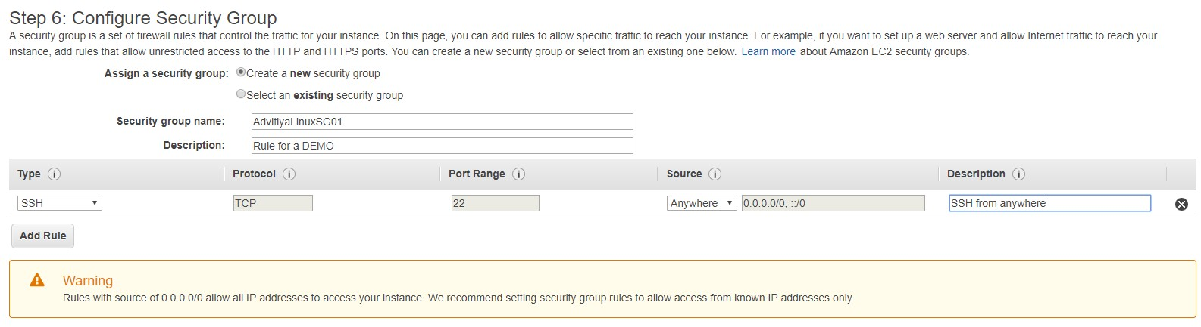
For example, if you want to write a rule to allow remote for a Linux Instance using SSH protocol from any IP address of IPv4 and IPv6, you can see the rule below:
(Fig. Security Group)
You find rules written in Security Group are permissive in nature, its mean you cannot create rules that deny access.
Security group are stateful in nature. In stateful characteristics, when you send a request from your instance, acknowledgement traffic for that request is allowed.
4. EC2 Key Pairs
AWS uses public key cryptography to login into EC2 Instance. Public key cryptography contains two keys, one is public key and another one is private key. Public key is used to encrypt the information and Private Key is used to decrypt the encrypted information. Both keys (Key Pair) are a part of a set.
AWS uses a pair of keys, in which Public key used to encrypt the password information and Private Key is used to decrypt the password.
You create key pair for login into EC2 Instance. One key pair can be used with multiple Instances for login purpose. Or you can create a separate

Slide 6
key pairs for each Instance. If needed, you can also import key pair from your external resources (third party tool).
AWS generated key uses 2048-bit and SSH-2 RSA algorithms. Your AWS account can have up to 5,000 key pairs per region. By default, you get a public key in .pem file format.
You can change the key pair that is used to access the default system
account of your instance. For example, if a user in your organization
requires access to the system user account using a separate key pair,
you can add that key pair to your instance. Or, if someone has a copy of
the .pem file and you want to prevent them from connecting to your
instance (for example, if they've left your organization), you can replace
the key pair with a new one.
5. Network Interfaces
On AWS, an EC2 Instance is a virtual machine. And every machine which is running on TCP/IP network requires an IP address to communicate other Instances. For that AWS provides a logical networking interface in a Virtual Private Cloud (VPC). Each EC2 Instance in a VPC has one default network interface eth0.
AWS allows you to create network interfaces in your account and attach the new network interface to EC2 instance in your network.
6. Public and Private IP Address
AWS does support both IPv4 and IPv6. By default, your instance will get one public IP and One Private IP address. Default public IP address is dynamic in nature, it is not static. EC2 Instance can have different IP address when you reboot the Instance. Therefor to fix one Public IP address with the Instance, you do use Elastic IP Address.

Slide 7
If you do not want the public IP on your Instance, you can disallow public IP for your Instance from VPC configuration dashboard. AWS support CIDR block in IPv4.
For internal communication amongst instances in the same network, AWS provides internal DNS hostname.
For example, ip-172-230-100-10.ec2.internal.
Elastic IP Address (EIP)
If you want to provide a fix public IP address (Static IP) to your EC2 instance or a network interface, Elastic IP address is a best solution. An Elastic IP address is linked with your account. AWS charges for EIPs. You can associate or disassociate EIP with your Instance or network resource any time.
Important about EIP:
An EIP is a public static IP address, which is reachable from any Instance.
Static IP address based instance can be reachable from the anywhere on internet.
In order to provide an entry for reverse DNS, an Elastic IP Address is needed in EC2 Instance.
Each AWS accounts have limit of 5 Elastic IP addresses per region.
In case of failure on an instance which is running an application on AWS, a new healthy instance can have same static IP address to provide application available on the Internet.
If there is a need of more static IP address for your architecture, you can raise your request for additional EIPs to AWS support.
Domain Name System (DNS) Name:
Every EC2 Instance on AWS has a public IP and Private IP. And to reach that machine over the Internet AWS provides a public DNS Name which

Slide 8
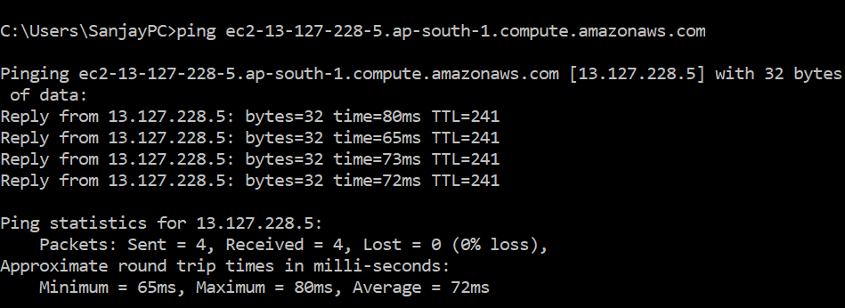
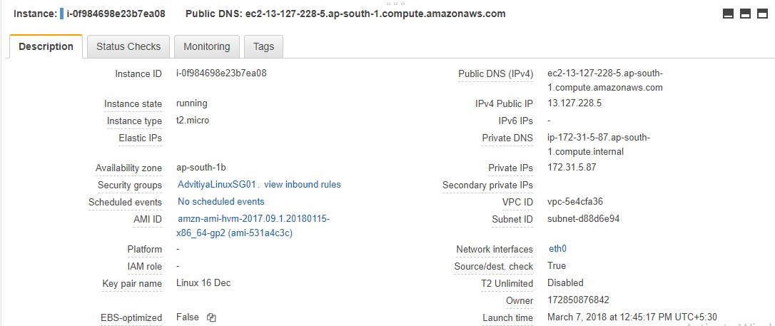
looks like this ec2-13-127-228-5.ap-south-1.compute.amazonaws.com. DNS Name of the instance consists the Public IP address, the region and the service. DNS Name of the Instance can be mapped with public registered DNS to reach the machine. To verify the reachability from the Internet, you can run ping command using public DNS. The Instance will give response only when its ICMP traffic is enabled.
In the Description tab of the Instance, you can see all details related to machine including Public DNS Name and IP addresses.

Slide 9
For more details on DNS, you will study about AWS service Route53.
9. Regions and Availability Zones (AZ):
AWS Cloud Computing resources available world-wide. They are segregated in various Regions and Regions further are classified in Availability Zones. AWS Regions are separated geographically. By default your resources do not replicate across AWS Regions. If you want to replicate them across resources, you need to specify.
Instance Metadata:
It is data about EC2 instance that you can use to manage and configure the running instance.
Instance metadata divided into four categories:
The instance ID
The Instance type
The Instance linked security group
Information about AMI used to launch the instance You can use curl command in Linux Instance to see Instance Metadata.
[ec2-user@ip<~>]$ curl http://169.254.169.254/latest/meta-data/

Slide 10
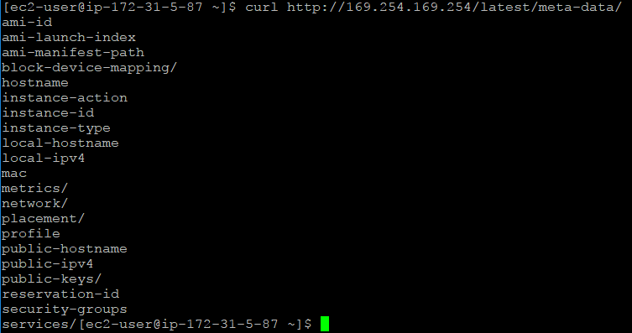
VM Import/Export
This feature of AWS is useful to migrate virtual machine from your existing environment to AWS EC2 Instance. In VM Import/Export you import your virtual machine as an AMI. Later on if it is needed, you can export them back to your on-premises environment. You cannot export EC2 Instances created within AWS using AWS provided AMIs.
This technology to import or export machines support with VMWare ESXi, VMWare Workstation, Microsoft Hyper-V and Citrix Xen virtualization formats.
Challenge Note: Here we leave one excellent opportunity to complete a demanding LAB, in which you can create a virtual machine using VMWare Workstation in your environment and try to import that virtual machine on AWS EC2 Instance.
Bootstrapping:

Slide 11
In some cases, after installation of an operating system in your instance, you want to install, upgrade or configure software. AWS cloud computing provides an amazing benefit to pass a script to manage these tasks automatically for the Instance. You can pass this script or code into the launch wizard as a file or simple text.
It’s easy to understand, the process of passing code to be executed on an Instance at launch time is known as bootstrapping.
Challenge Note: Why don’t you write a list of command in a sequence to install and configure an Apache Server in Linux Instance, and pass it on to the instance at the time of launch.
13.EC2 Instance Storage – Elastic Block Storage (EBS):
EBS volumes in virtual machines (Instances) behave like hard disk drives in physical volumes. EBS is a block level storage. EBS volume to be attached with EC2 instances. And multiple volumes can be attached to an instance. EBS volumes provide high availability and durability.
Types of EBS in AWS:
General Purpose SSD
Provisioned IOPs SSD
Magnetic Volumes
Characteristics | General Purpose | Provisioned IOPS | Magnetic

Slide 12
SSD SSD
Purpose | System Boot | Critical Business | Cold Workloads
 | Used for small to medium size business needs | Application require better performance and higher IOPS rate | Used where infrequent of data access required
Raid 0 can be implemented
IOPS | Performance of 3 IOPs/GiB | High performance maximum up to 20000 IOPs | 100 IOPs as an average and burst up to a few hundred
Throughput | 160 MB | 320MB | 40-90 MB
Volume Size | 1 GiB to 16 TiB | 4 GiB to 16 TiB | 1 GiB to 1 TiB
Snapshots:
This is a backup and recovery method of data for your EBS volumes. The snapshots are point-in-time backup of an EBS volume. The EBS Snapshots are incremental and cost effective solution. If multiple backups are taken of a volume, they are incremental. An incremental backup is a type of backup method which copies files that have changed since the last backup. The EBS data restore process creates a volume from snapshots that can be attached with EC2 instance. EBS volumes can be encrypted.

